Slide 1


UdbhavaX'26
Project Title:A Weather-Based Farming Advisory System
Domain:AG_10(Agri Tech)
Team Name:Code Tech
Team Members:K.Keerthi Reddy,B.Sherlin Varshitha,K.Varshitha,V.Vyshnavi
Department:CSE-AIML
Event:UdbhavaX’26,Coding Club,SR University
codingclub@sru.edu.in

Slide 2
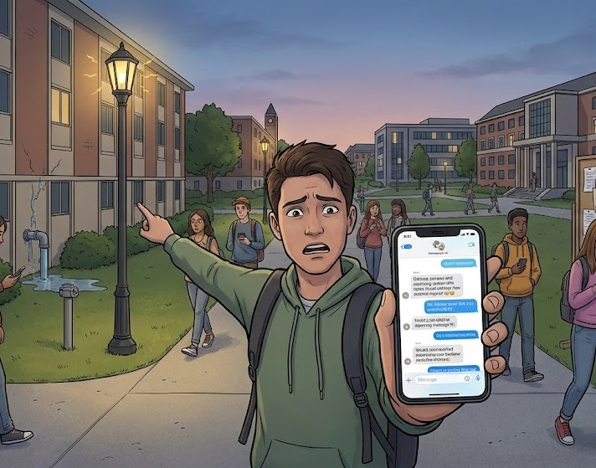
Problem Scenario
The Real-World Situation: In Rajasthan, farmers rely on rainfall and depend on TV or word-of-mouth for weather updates.These sources provide only general information, not specific to individual villages. Current Failure: Weather information is often delayed and not accurate for local conditions.There is no system for timely alerts on extreme weather like droughts or heavy rainfall.This leads to wrong farming decisions, crop damage, and financial losses.
codingclub@sru.edu.in

Slide 3
Current Pain Points (Why it Breaks)
No Location-Specific System: Farmers receive general weather updates, not tailored to their village, leading to inaccurate decisions.
Delayed & Unstructured Communication: Information comes via TV or word-of-mouth, causing delays and misinformation.
No Early Warning Mechanism: Sudden droughts or heavy rainfall are not predicted or alerted in time.
Lack of Data & Decision Support: No historical records or advisory system to guide crop planning and seasonal decisions.
codingclub@sru.edu.in

Slide 4
Objectives & Success Criteria
Primary Objective:
To build a centralized Weather-Based Farming Advisory System that delivers timely, location-specific weather updates and crop recommendations to farmers in Rajasthan.
Success Criteria:
Provide accurate, location-based weather data for each registered farmerSend real-time alerts for extreme weather conditions.
Generate crop and seasonal recommendations based on weatherMaintain weather history and reports for analysis.
Ensure easy access and usability for farmers and officers
codingclub@sru.edu.in

Slide 5
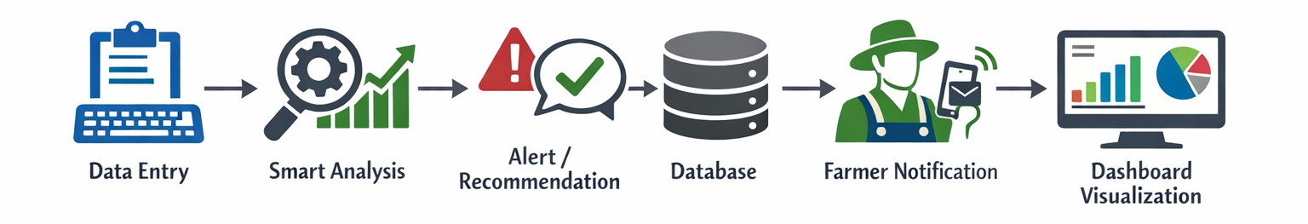
Proposed Solution Strategy
Key Solution Strategies:
Location-Based Updates – Village-specific weather data
Smart Alerts – Automatic extreme weather notifications
Role-Based Access – Separate views for farmers and officers
codingclub@sru.edu.in

Slide 6
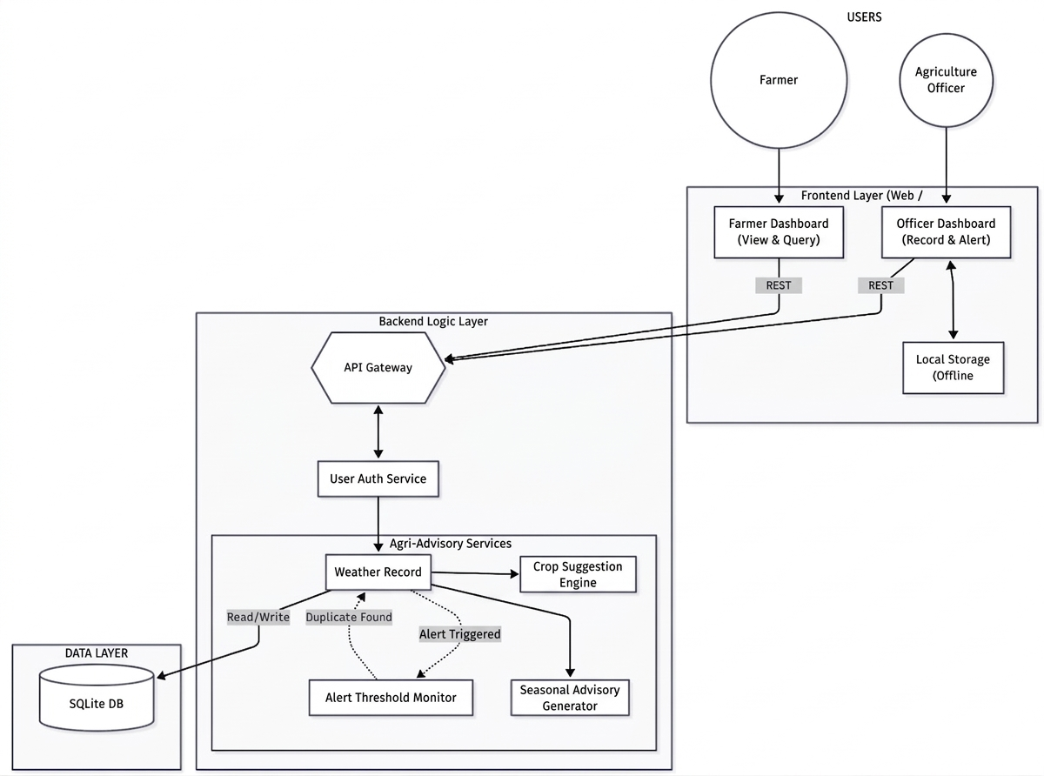
System Architecture
Architectural Overview (3-Tier):
Frontend Layer: Farmer & Officer dashboards for viewing data and alerts.
Backend Layer: Processes data, generates recommendations, triggers alerts.
Data Layer: Stores weather data, users, and history
codingclub@sru.edu.in

Slide 7
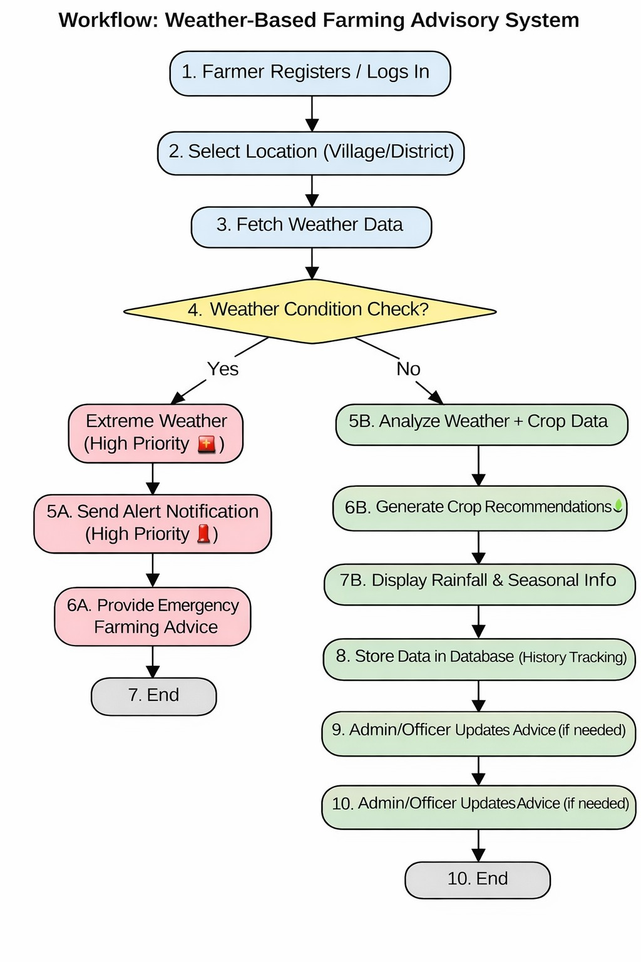
Data Flow / Workflow
Data Flow / Workflow (Short): Registration: Farmer registers with village/location Data Entry: Officer inputs weather data (rainfall, temperature, humidity) Processing: System checks data using threshold logic Decision: Generates alert (extreme) or recommendation (normal) Storage: Data saved in central database Output: Farmers view alerts & advice, officers monitor reports
codingclub@sru.edu.in

Slide 8
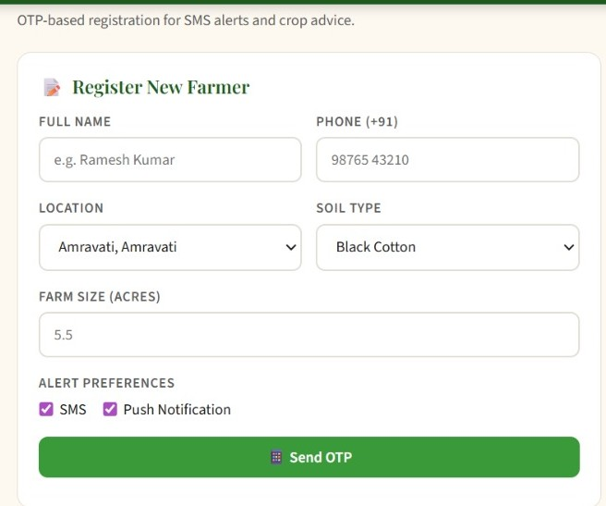
Implementation & Demo Reference
Implementation & Demo Reference:
Implemented Features (ReferencePrototype):
Farmer Registration System with location-based details
Dashboard View for farmers (alerts/advice) and officers(monitoring & reports)
codingclub@sru.edu.in

Slide 9
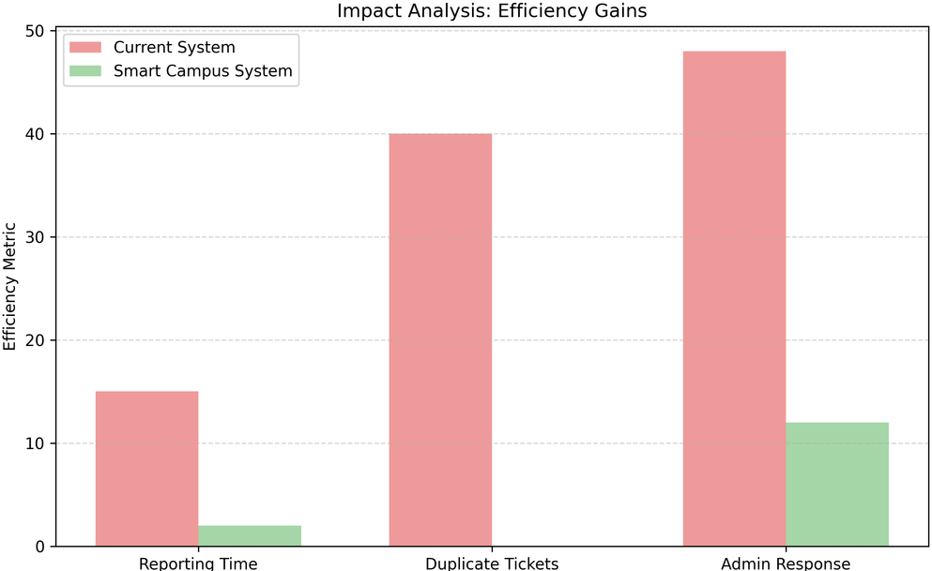
Impact & Benefits
Timely Decisions: Farmers get quick weather updates and alerts Reduced Crop Loss: Early warnings help prevent damage Better Planning: Crop recommendations improve yield Data Insights: Weather history helps in future decisions
codingclub@sru.edu.in

Slide 10
Limitations
Data Storage: Uses basic/local storage; can be upgraded to cloud database Authentication: Simple login system; no advanced security (OTP/MFA) Data Source: Weather data is manually entered, not real-time API Offline: Requires internet; no offline support.
codingclub@sru.edu.in

Slide 11
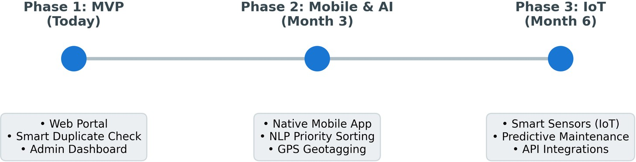
Future Scope & Roadmap
Future Scope & Roadmap (Short)Phase 2: Intelligence & MobileAI-based crop recommendationsMobile app with notifications & GPS
Phase 3: Smart IntegrationLive weather API integrationIoT sensors for automatic data collection
codingclub@sru.edu.in

